Slide 1

La CBE JU: la bioeconomia europea dal laboratorio alle bioraffinerie
Virginia Puzzolo
Head of Programme
11 December 2025
Bioeconomia circolare il ruolo delle catene del valore per le filiere locali

Slide 2
The new Strategic Framework for a Competitive and Sustainable EU Bioeconomy
scaling innovation and investments: from Lab to Deployment
building new lead markets for bio-based materials and technologies
ensuring sustainable biomass supply across value chains
harnessing global opportunities

Slide 3
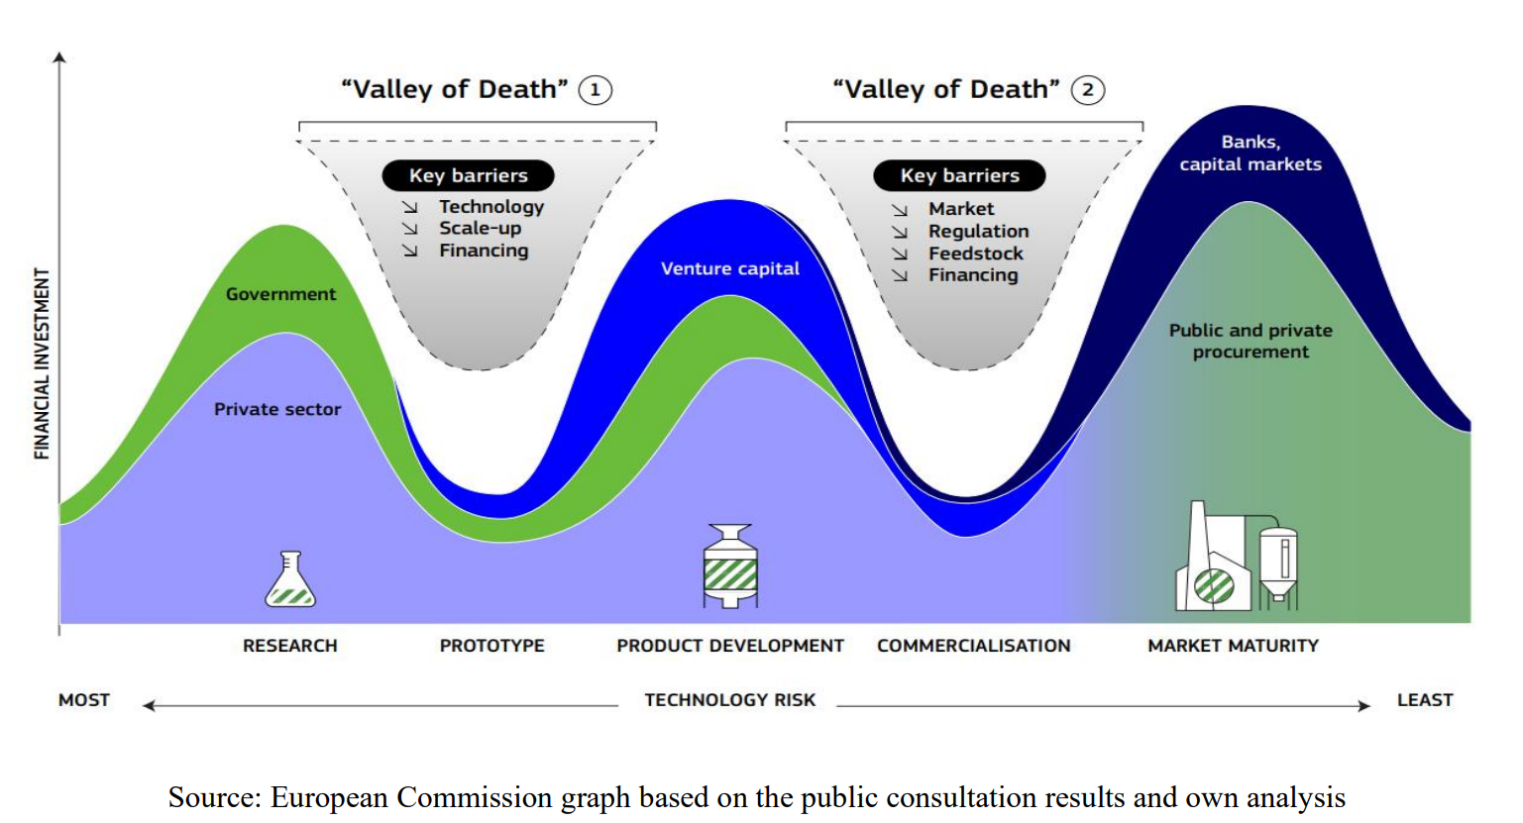
Two valleys of death in scaling bioeconomy in Europe

Slide 4


A competitive bioeconomy for a sustainable future
Circular Bio-based Europe Joint Undertaking
Supporting the European Green Deal
€2 billion public-private initiative
Part of Horizon Europe, the EU R&I funding programme
European Union
Represented by the European Commission
+
Building on the success of its predecessor BBI JU
CBE JU is funding projects that deliver bio-based solutions - materials and products made from waste and biomass - in an innovative, sustainable and circular way.
Launched in 2021, operates until 2031
1

Slide 5



A competitive bioeconomy for a sustainable future
CBE JU three key objectives
Accelerate the innovation process and development
of bio-based innovative solutions
Accelerate market deployment of the existing mature bio-based innovative solutions
Ensure a high level
of environmental performance of bio-based industrial systems
2

Slide 6




A competitive bioeconomy for a sustainable future
Large-scale first-of-its-kind product facility in Europe
Types of actions funded by the CBE JU
Scale up and demonstration
of technologies
Development and validation of technologies
3
4
5
6
7
8
1
2
9
RIA Research and Innovation Actions
IA Innovation Actions (including Flagships)
Technology Readiness Level (TRL)
CSA: Coordination and Support Actions (no link with TRLs)
3

Slide 7
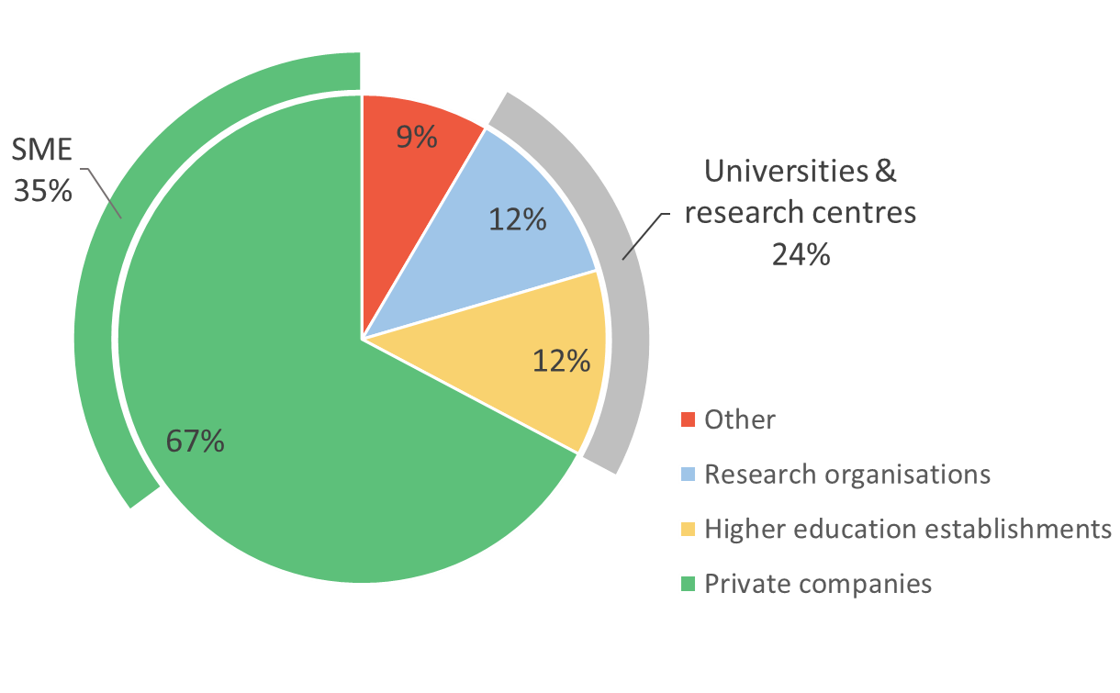



A competitive bioeconomy for a sustainable future
CBE JU portfolio
CBE JU portfolio
CBE JU unique participants* per type of legal entity
2014-2024
220 projects
3,109 participants*
€1,281 million CBE JU funding
45 countries
*including beneficiaries, affiliated entities, and associated partners
Data: CORDA, May 2025
04

Slide 8



Main feedstock types
AQUATIC
AGRI-FOOD
FOREST-BASED
18 projects
60 projects
43 projects
Micro & macro algae, by-products from fishery
Lignocellulosic biomass, wood residues
Forest-based
&
SIDESTREAMS FROM INDUSTRY
Aquatic
&
Agri-food
Agri-food
2project
8 projects
Sidestreams from pulp and paper industry
Agri-food
&
Other
Starches, sugars, agricultural residues, molasses, manure, flax, vegetable oils
Agri-food
&
Organic waste
Organic waste
&
Forest-based
4 project
31 projects
2 projects
1 project
OTHER
BIOGENIC GASEOUS CARBON
ORGANIC FRACTION OF MUNICIPAL SOLID WASTE
9 projects
6 projects
10 projects

Slide 9







Areas of applications
Construction
)
Textile
s
(
s
B
e
u
n
s
i
in
s
16
e
u
s
B
9
s
-
projects
-
o
T
T
o
-
projects
-
s
C
s
e
o
n
n
i
Bio-based materials
s
s
Packaging
u
u
B
Crop protection and fertilisation
m
(
e
r
)
B2B
40
25
B2C
projects
projects
12
projects
Bio-based chemicals
Food, feed & cosmetics
37
47
projects
projects

Slide 10
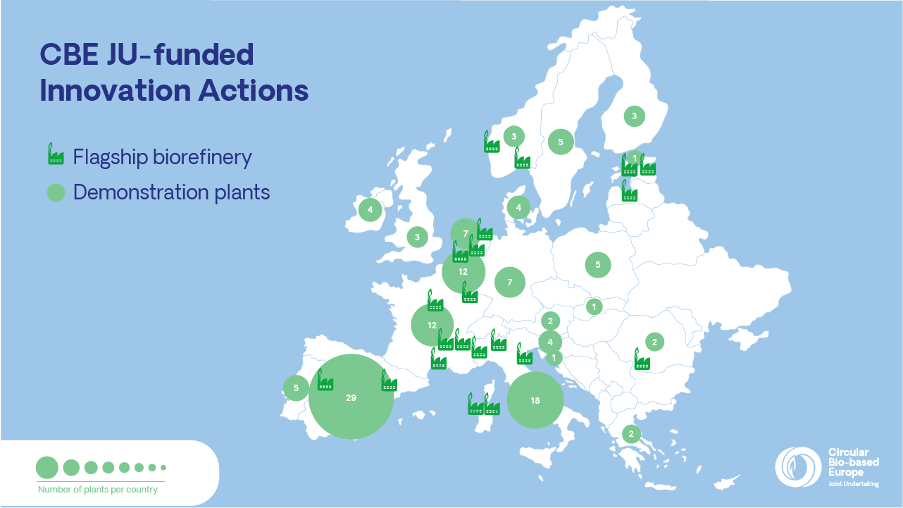

Slide 11
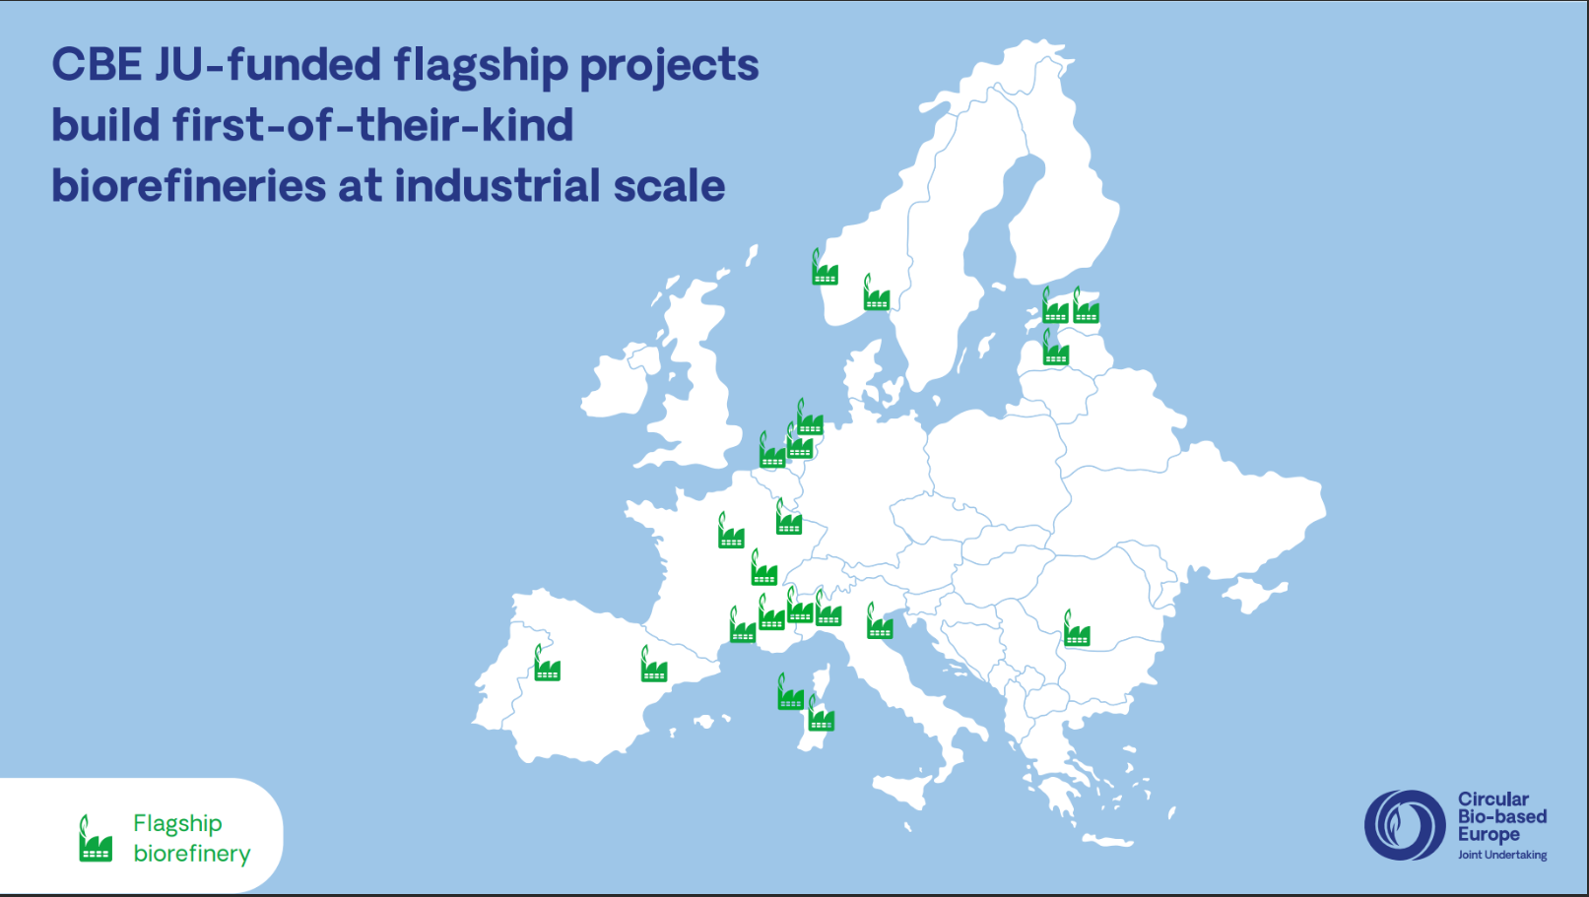
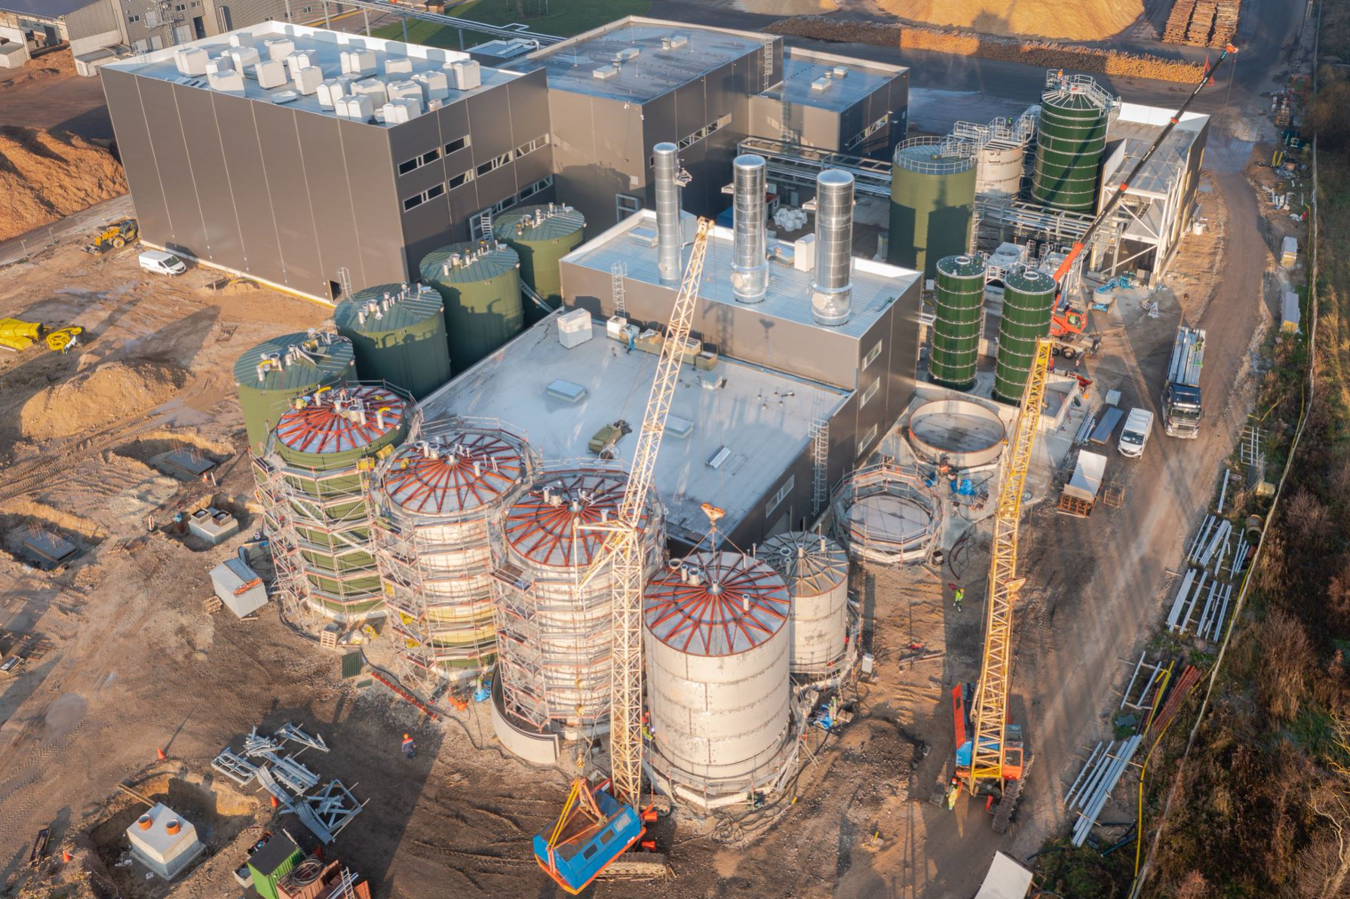
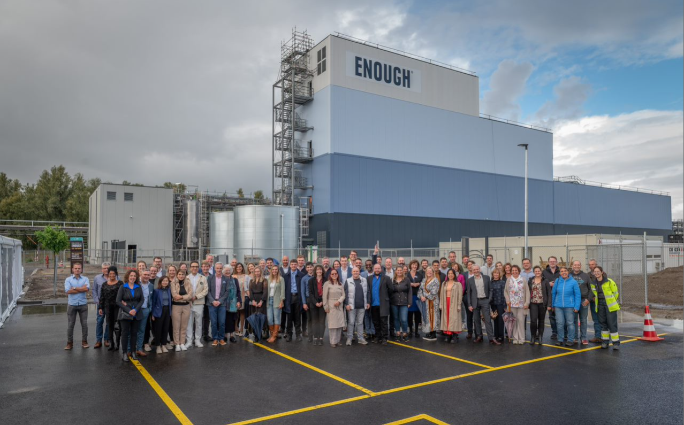
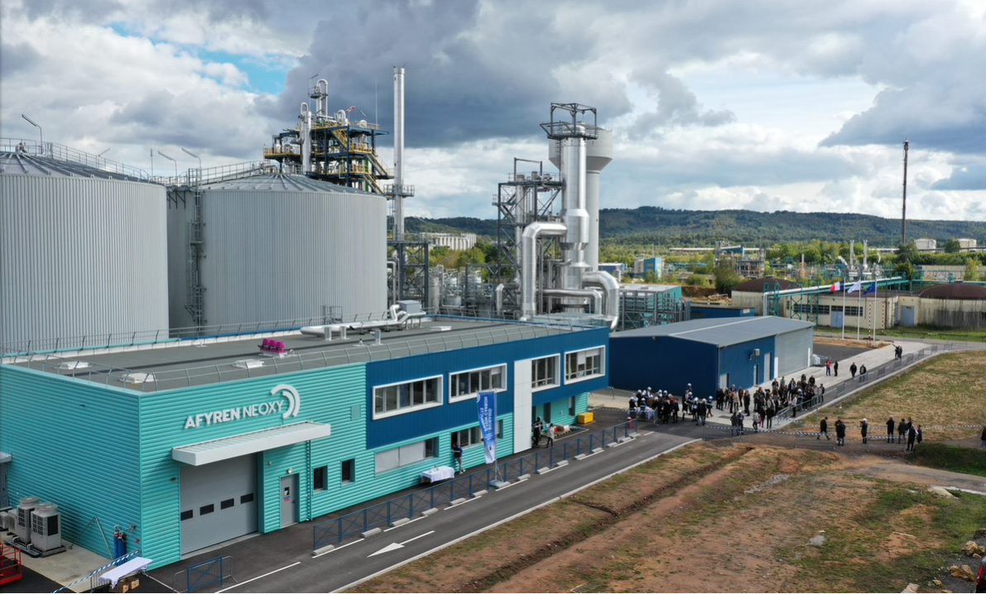
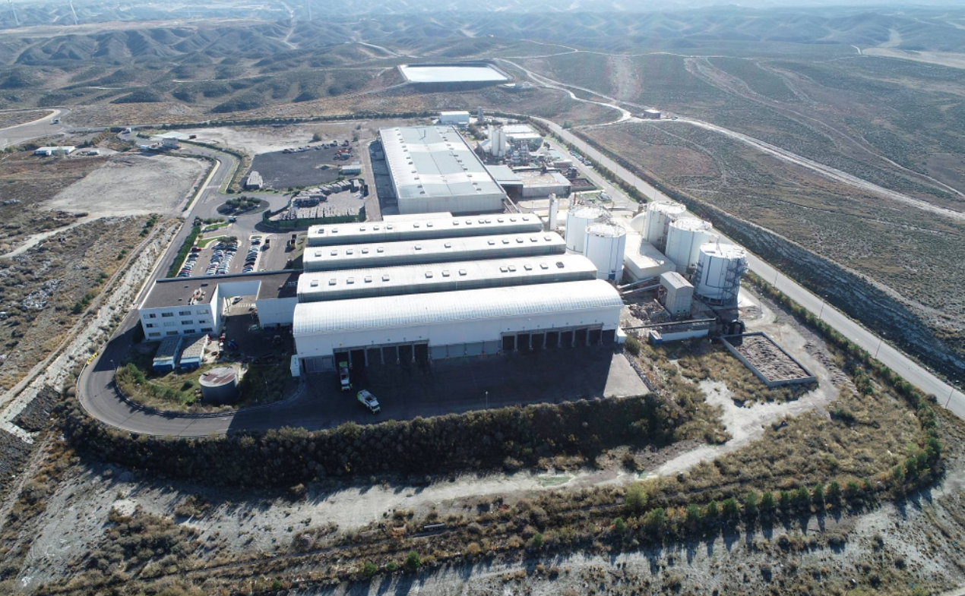
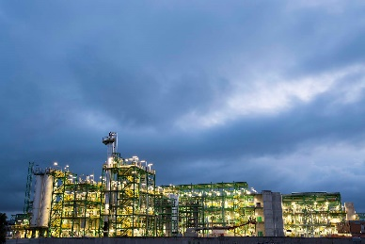
SWEETWOODS, Estonia
PLENITUDE,
the Netherlands
AFTERBIOCHEM, France
CIRCULAR-BIOCARBON, Spain & Italy
FIRST2RUN, Italy

Slide 12
CBE JU Policy hurdles analysis
Overarching:
feedstocks, processes and products
Ecodesign for Sustainable Product Regulation
Emission Trading System Directive
Land Use, Land Use Change and Forestry Regulation
NACE Regulation
Renewable Energy Directive
Sustainable Finance Taxonomy Regulation
Waste Framework Directive
Policy initiatives
Bio-based chemicals
Classification, labelling and packaging of substances and mixtures Regulation
REACH Regulation
Bio-based materials & packaging
Packaging and Packaging Waste Directive
Single-Use Plastics Directive
Regulation on plastic materials and articles intented to come into contact with food
Crop protection
& fertilisation
Common Agriculture Policy (CAP)
EU Fertilisers Regulation
Plant Protection Products Regulation
Sustainable Use of Pesticides Directive
Food&Feed Ingredients
Novel food Regulation
Feed additives Regulation
6

